Slide 1



Data Arrangement of A
Chart Can Afford Different Viewer Conclusions
Cindy Xiong, Northwestern University/UMass Amherst
Eunyee Koh, Adobe Research
Steve Franconeri, Northwestern University
Notes:
Pointer – mouse!!

Slide 2
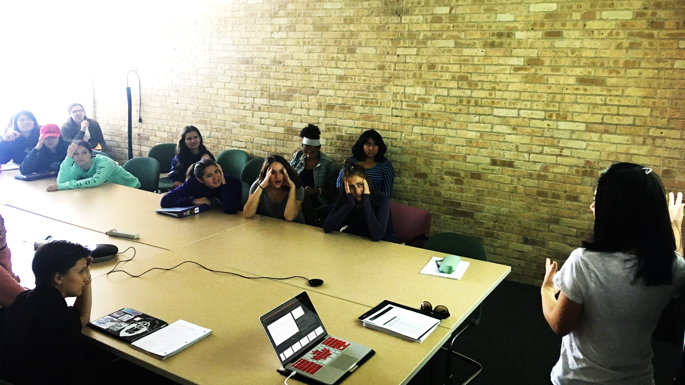
Notes:
I took this picture in the good old days – it was supposed to demonstrate how horrible of a teacher I am, but today, I want to use it to set a scene and pretend we are all in Swift 210, having a great time together.

Slide 3
Design choices can lead to powerful and intuitive insights, or leave important patterns obscured and misunderstood.
Notes:
For today, I want to talk about how we can design visualizations that best align with user goals.
well-designed data visualizations can lead to powerful and intuitive insights,
But poorly chosen visualizations can leave important patterns obscured and misunderstood.

Slide 4
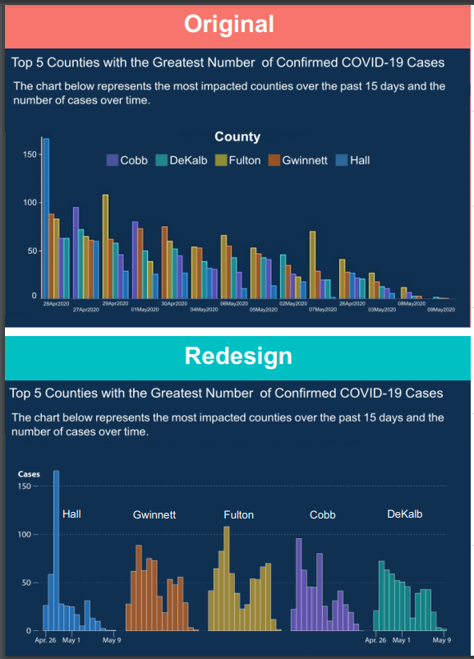
Design choices can lead to powerful and intuitive insights, or leave important patterns obscured and misunderstood.
28 April
27 April
2 May
1 May
30 April
4 May
6 May
5 May
2 May
7 May
26 April
3 May
8 May
9 May
Misleading decreasing trend.
Notes:
Let’s look at this example –
Here we have a chart depicting the number of COVID-19 cases reported over two weeks in the five counties in Georgia.
Let’s take a moment to look at this.
At first glance, you may be thinking it’s depicting a downward trend, suggesting that the number of covid cases are decreasing over time.
Then you realize that’s not the case. The dates are not ordered, and the data is sorted by severity instead.
So the downward trend you see is misleading.

Slide 5





Design choices can lead to powerful and intuitive insights, or leave important patterns obscured and misunderstood.
28 April
27 April
2 May
1 May
30 April
4 May
6 May
5 May
2 May
7 May
26 April
3 May
8 May
9 May
26 April
May 9
26 April
May 9
Misleading decreasing trend.
No more misleading decreasing trend.
Notes:
You could alternatively show the same data via a different design.
Here we have a second version sorting the data by county, and the x-axis is ordered by dates.
Now it’s clear that the trend over time isn’t simply decreasing, *click
you can see a much clearer bi-modal distribution of cases. *click

Slide 7
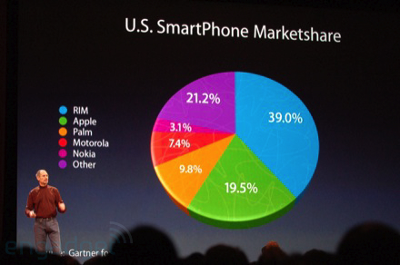
Notes:
Here is another one.
When Smartphones was just becoming popular, this is what Steve Jobs presented at one of his keynotes. He showed the US smartphone marketshare and as you can see here, the green is Apple and they occupy a pretty big chunk of the market.
He kept talking as he showed this so the audience really had their attention on him. But let’s stare at this chart for a second since we have time, you may notice that something is slightly off.
Why does this 19.5% look bigger than this 21.2%?
You see, Steve Jobs is a smart man, and he used data visualization techniques to play a trick on us.

Slide 8
Notes:
By showing the same data via a 3D pie chart compared to a 2D pie chart, you can see how it distorts the proportions, making some look bigger than others?
I made these in Excel – identifcal data set, but you can clearly see that the green looks bigger on the left, and smaller on the right.

Slide 10
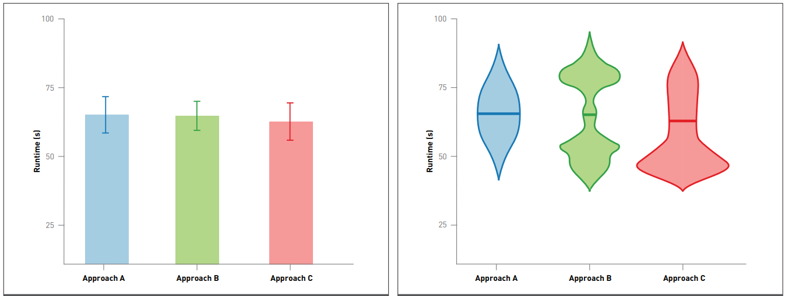
Recovery Rate
Recovery Rate
Treatment 1
Treatment 2
Treatment 3
Treatment 1
Treatment 2
Treatment 3
No difference between the three treatments.
Actually, they are quite different.
Notes:
Here is another example. Let’s look at this dataset,
It shows the recovery rate of three treatments. You’d see charts like this in a Psych journal all the time, and you would probably conclude that there is no difference between the three treatments.
But, once you ditch the bar chart presentation format and show the underlying distribution of the data, you can tell that the three treatments are quite different.

Slide 11




Visualization 2
Data
Interpretation 2
Data Scientists
Information Consumer
Notes:
Although it may seem easy to critique the visualization and identify the problems in hindsight, designing a visualization is very complicated. Here is how it typically works.
First, researchers need to collect the data.
Data scientist to analyze and generate insight from data, then design the visualization and interaction.
Before it reaches the end-user, or the information consumer.
And this process, in reality,

Slide 12


Visualization 1
Interpretation 1
Visualization 2
Data
Interpretation 2
Data Scientists
Interpretation 3
Visualization 3
Notes:
the process looks more like this this. Because -

Slide 13
Designing a visualization involves a series of decisions, and each design decision can afford different interpretations.
Visualization 1
Interpretation 1
Visualization 2
Data
Interpretation 2
Data Scientists
Interpretation 3
Visualization 3
Notes:
Designing a visualization involves a series of decisions, and each design decision can afford different interpretations.
You saw that from the earlier Georgia coved case example, the way the bars were spatially arranged really changed how the chart could be understood.

Slide 14
Designing a visualization involves a series of decisions, and each design decision can afford different interpretations.
magnitude comparison
proportions
relative changes
West
West
East
East
East
A
Revenue
East
A
B
Revenue
West
B
West
A
B
West
East
Company A’s revenue is higher overall.
West A makes the most amount of revenue.
The change in revenue from West to East is bigger in A than in B.
Notes:
To help visualization designers make these decisions, visualization researchers have been studying how different design choices could lead to different viewer tasks and conclusions.
For example, bar charts makes you think of discrete bins, pie charts make you think about porpotions, and line charts emphasize trends.
They have incorporated these results into visualization recommendation system to help designers make these decisions and generate more effective visualizations for there data.

Slide 15
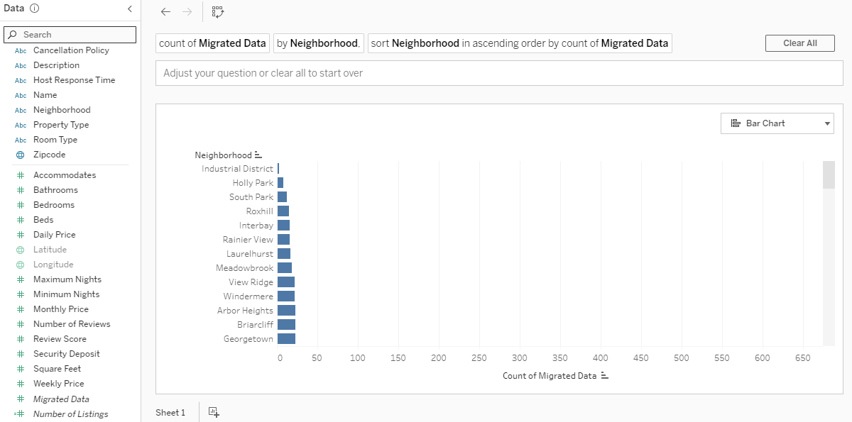



show Daily Price over Time
Price
Time
Price
Time
Tableau, Ask Data
Notes:
Here is what these type of systems tend to look like.
Here we have the Ask Data tool built by Tableau, which recommends visualizations based on user queries.
when viewers ask a question, such as asking the system to show the change in Daily Price over time, *click
They could type this using natural language,
these recommendation system would recommend a visualization to help the viewer answer this question.
For this example, the system would likely recommend a line chart to emphasize the change over time, *click
Rather than showing a bar chart where data is discretized into bins. *click
But there is a lot more we need to research still to refine visualization recommendation tools like this.

Slide 16
show how Company A did compared to Company B in Revenue
A
West
A
B
West
B
East
Revenue
Revenue
East
West
East
A
B
Tableau, Ask Data
Notes:
For example, let’s say the user wants to know how Company A did compared to Company B in Revenue,
What should the recommendation system show us? Should it show us the data like this, or like this?

Slide 17
show how Company A did compared to Company B in Revenue
Revenue
East
Revenue
A
Revenue
West
B
West
East
A
B
Tableau, Ask Data
Notes:
Perhaps it could show it to us like this, or like this instead.

Slide 18
show how Company A did compared to Company B in Revenue
West
East
Revenue
Revenue
East
West
A
B
A
B
Tableau, Ask Data
Notes:
Or maybe, it could recommend the visualization like this, or like this.
I could go on for a couple hours, and you get my point –
there are so many design decisions that goes into visualizing even a simple set of data, and each design decision could lead to a different viewer take-away.

Slide 19
A
A
B
B
Revenue
West
East
What do you conclude from this?
Notes:
Let’s experience it ourselves:
What do you conclude from this?

Slide 20
A
A
B
B
Revenue
West
East
West has overall higher revenue for both A and B.

Slide 21
A
West
A
B
West
B
East
Revenue
Revenue
East
West
East
A
B
West has overall higher revenue for both A and B.
What do you conclude from this?
Notes:
What about this?

Slide 22
A
West
A
B
West
B
East
Revenue
Revenue
East
West
East
A
B
West has overall higher revenue for both A and B.
Company A’s revenue is higher overall.

Slide 23
Revenue (million $)
 | A | B
West | 50 | 33
East | 29 | 25
A
West
A
B
West
B
East
Revenue
Revenue
East
West
East
A
B
West has overall higher revenue for both A and B.
Company A’s revenue is higher overall.
Notes:
You realize it’s the same data, but you have the tendency to compare West to East on the left,
And A to B on the right.

Slide 24

show how Company A did compared to Company B in Revenue
Does this afford the comparisons the viewer wants to make?
A
A
B
B
Revenue
West
East
Notes:
So when people are using visualization recommendation tools like Ask Data, how can we recommend users the visualization that best align with their intent?

Slide 25
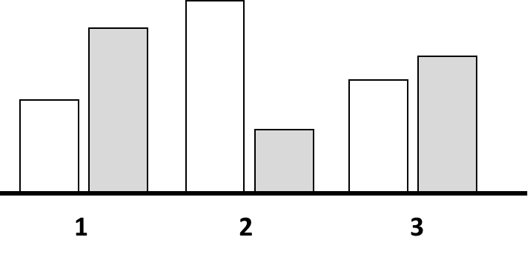
Chart 1
Comparison 1
Chart 2
Chart A
Comparison 2
My conclusion is …
Chart 3
Comparison 3
Show people visualizations and ask them to write sentences describing their take-aways.
Create a mapping between the visualizations shown and the type of take-aways they tend to elicit.
Notes:
To study this, we are going to reverse engineer the process by showing people visualizations, and asking them to write sentences describing their take-aways.
*Click
This will help us create a mapping between the visualization and the type of take-aways they tend to elicit, such as the types of visual comparisons people tend to do upon seeing that visualization,

Slide 26

Chart 1
Comparison 1
Show me how 1 compares to 2 and 3
Chart 2
Chart A
Comparison 2
My conclusion is …
Chart 3
Comparison 3
Show people visualizations and ask them to write sentences describing their take-aways.
Create a mapping between the visualizations shown and the type of take-aways they tend to elicit.
Generate guidelines to recommend the visualization that best aligns with user goals.
Notes:
This mapping can finally be incorporated in visualization recommendation systems so that we know which visualization to give them that best algins with their goals.
This is an ambitious space to operate in, as there exists so many design decisions in a visualization that could influence the comparisons people make.

Slide 27
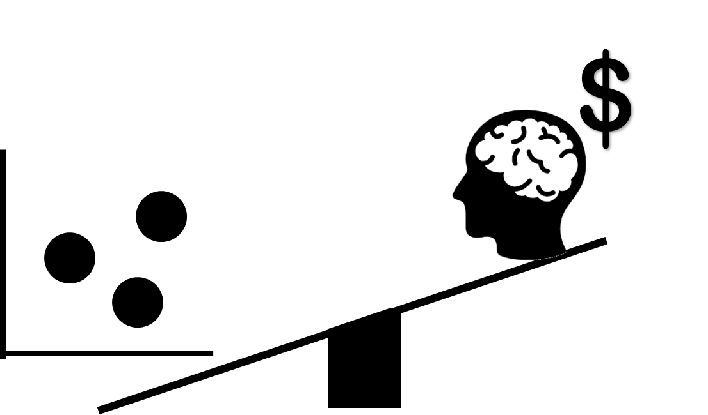
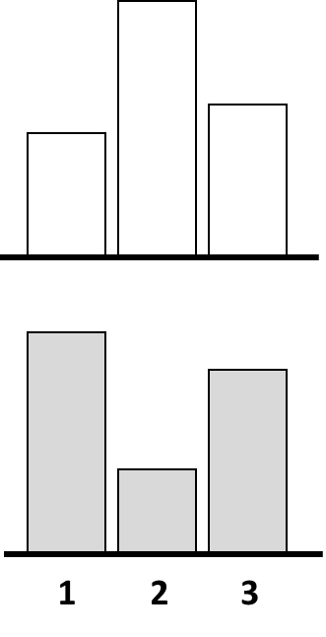
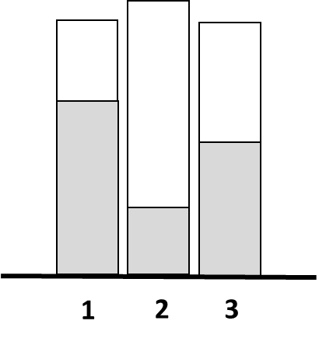
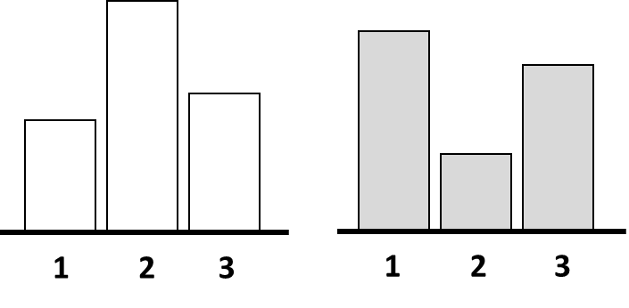
Effect of Spatial Arrangement on Comparison Affordances
Vertical
Overlaid
Adjacent
Stacked
Notes:
As our first step, we isolated spatial arrangement, and investigate how that affects people’s take-aways from a visualization.
To do this, we first identified some common spatial arrangements in the visualization world that could afford different visual comparisons of data.
Vertically aligned small multiples, overlaid bars, adjacently aligned small multiples, and stacked bars.

Slide 28
What would you conclude from this chart?
My conclusion is that…
Notes:
The way we executed our experiment was simple. We showed participants simple bar visualizations and asked them for their main take away.

Slide 29
<
>
I see that Group 1 and Group 2 are the opposite of each other.
Notes:
Because we recognize that verbal descriptions could be ambiguous, they also provided a drawing for us to clarify what they mean.
For example, for this participant could write “that Group 1 and Group 2 are opposite of each other”.
Based on the sentence we don’t know if they’ve compared this to this, and this to this, to show that one is smaller than and the other is larger than.

Slide 30
I see that Group 1 and Group 2 are the opposite of each other.
Notes:
Or that they’ve compared this to this, and noticed the increasing trend, and then this to this, and noticed the decreasing trend.

Slide 31
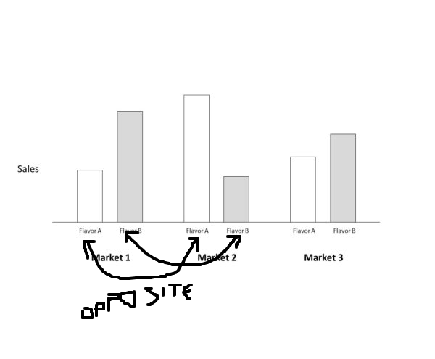
<
>
I see that Group 1 and Group 2 are the opposite of each other.
Notes:
Their drawing, however, clarified this for us. So we know that this participant compared the two white bars, and then the two gray bars.

Slide 32
What would you conclude from this chart?
My conclusion is that…
Notes:
We showed participants these bar visualizations and asked them for their main take away, which they provided both through a verbal sentence and a drawing.

Slide 33
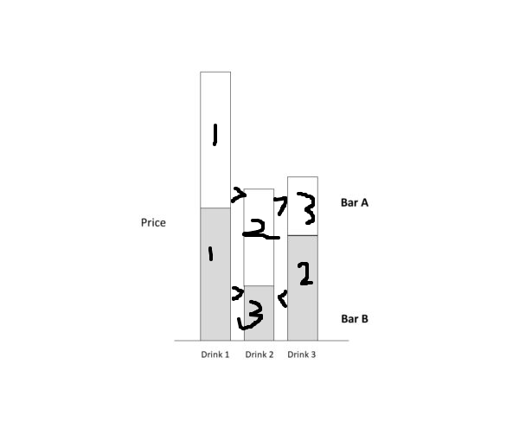
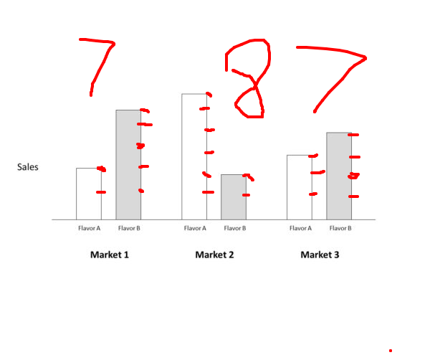
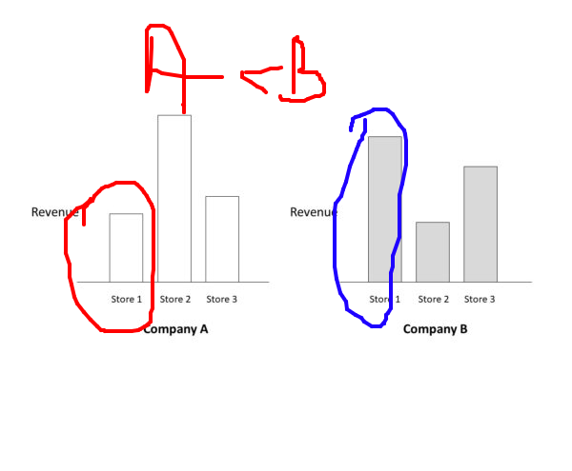
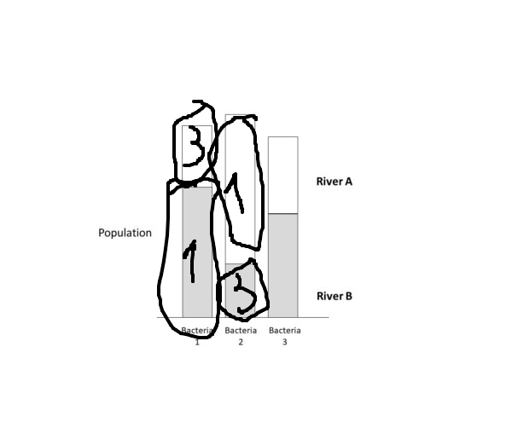
What would you conclude from this chart?
Vertical
Overlaid
Adjacent
Stacked
My conclusion is that…
My conclusion is that…
My conclusion is that…
My conclusion is that…
Notes:
Every participant viewed all four visual arrangement types,
They verbalized their take-aways and provided drawings to clarify what they meant for each.

Slide 34
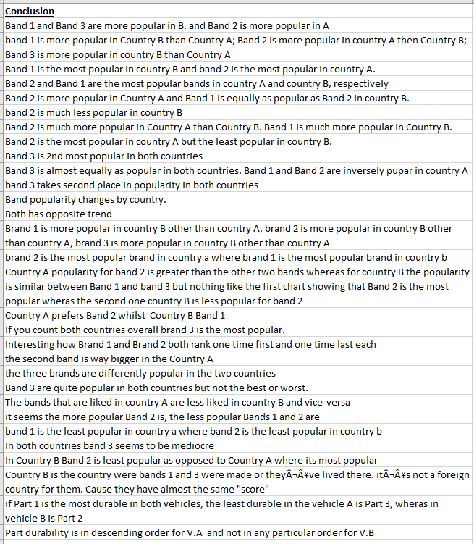
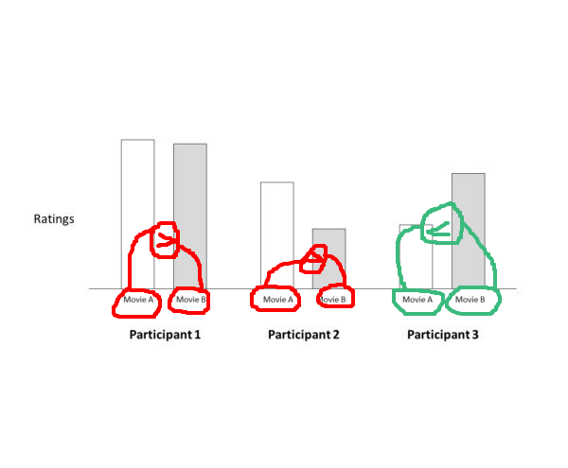
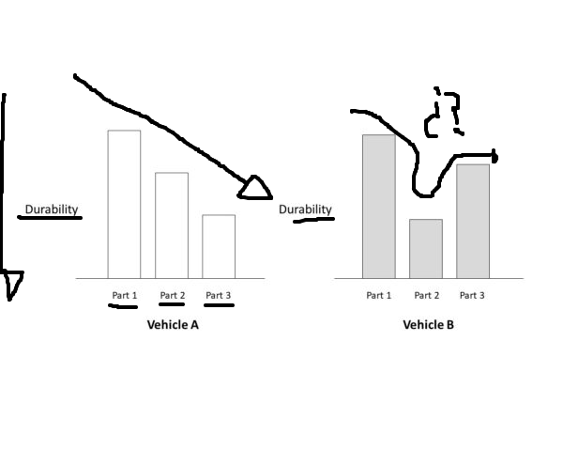
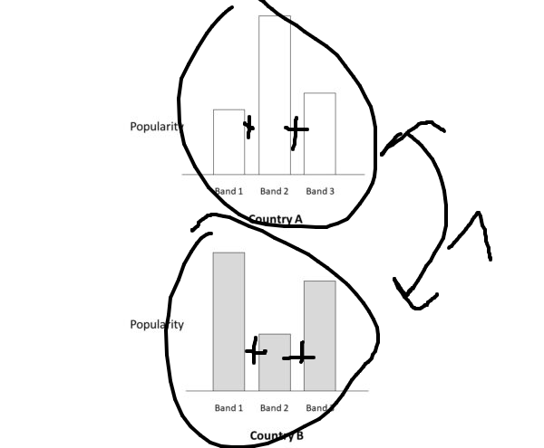
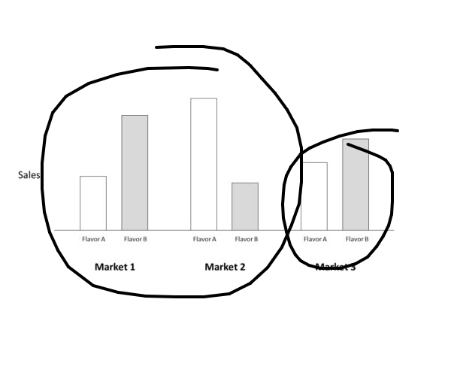
Notes:
What we end up collecting is a list of verbal take-aways and corresponding drawings.

Slide 35
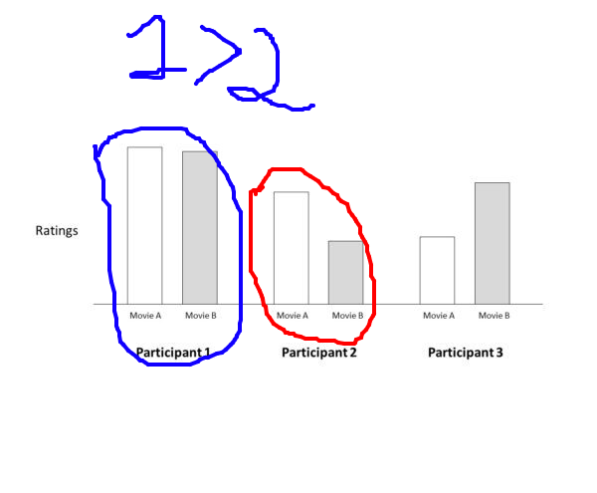


Participant 1 gave higher ratings to movies than Participant 2.
me
Notes:
Now, to make sense of what our participants wrote, we analyzed their verbal description, in conjunction with the drawing.

Slide 36



Target 1
Relation
Participant 1 gave higher ratings to movies than Participant 2.
Target 2
Notes:
Now, when it comes to categorizing take-aways, most of them involves a comparison.
Participants identified some objects of interest that’s to be compared and expressed the relation between them.
We went through every single sentence participants wrote, and identified which graphical elements were the targets of comparison, and the relation they compared.
Since we have limited time, I’ll provide an overview of several popular comparison types participants expressed in our experiment.

Slide 37
 | Verbal Description | Type
 | Component 2 is the most durable component in vehicle A. | Superlatives
 | The total durability of components in vehicle A is higher than that in vehicle B | A-B comparison (large group)
 | Overall component 2s are more durable than components 3s. | 2-3 comparison (small group)
 | In vehicle A, component 3 is more durable than component 1. | Pair-comparison (aligned big group)
 | Vehicle A’s component 1 is less durable than vehicle B’s component 1 | Pair-comparison (aligned small group)
Durability
Vehicle A
Durability
Vehicle B
1
2
3
Vehicle Component
Notes:
I’m going to use the vertical visual arrangement as an example here,
and I’ll show you some examples of verbal take-aways participants wrote, and show you how we categorized them.
This chart is about the durability of 3 car components in vehicle A and B.

Slide 38

 | Verbal Description | Type
 | Component 2 is the most durable component in vehicle A. | Superlatives e.g., max = A
 | The total durability of components in vehicle A is higher than that in vehicle B | A-B comparison e.g., A > B
 | Overall component 2s are more durable than components 3s. | 2-3 comparison e.g., 1 > 2
 | In vehicle A, component 3 is more durable than component 1. | Pair-comparison (AB) e.g., A1 > A2
 | Vehicle A’s component 1 is less durable than vehicle B’s component 1 | Pair-comparison (1-2-3) e.g., A1 > B1
Durability
Vehicle A
Durability
Vehicle B
1
2
3
Vehicle Component
Notes:
The first comparison type someone could come up with is what we call ‘superlatives’
This involves pointing out things to be the largest,

Slide 39





 | Verbal Description | Type
 | Component 2 is the least durable component in vehicle B. | Superlatives e.g., min = B
 | The total durability of components in vehicle A is higher than that in vehicle B | A-B comparison (large group)
 | Overall component 2s are more durable than components 3s. | 2-3 comparison (small group)
 | In vehicle A, component 3 is more durable than component 1. | Pair-comparison (aligned big group)
 | Vehicle A’s component 1 is less durable than vehicle B’s component 1 | Pair-comparison (aligned small group)
Durability
Vehicle A
Durability
Vehicle B
1
2
3
Vehicle Component
Notes:
Or the smallest.

Slide 40
 | Verbal Description | Type
 | Component 2 is the most durable component in vehicle A. | Superlatives e.g., max = A
 | The total durability of components in vehicle A is higher than that in vehicle B | A-B comparison e.g., A > B
 | Overall component 2s are more durable than components 3s. | 2-3 comparison e.g., 1 > 2
 | In vehicle A, component 3 is more durable than component 1. | Pair-comparison (AB) e.g., A1 > A2
 | Vehicle A’s component 1 is less durable than vehicle B’s component 1 | Pair-comparison (1-2-3) e.g., A1 > B1
Durability
Vehicle A
Durability
Vehicle B
1
2
3
Vehicle Component
Notes:
The second type is what we refer to as A-B comparisons.
These are scenarios where the participant either sums up or averages the vehicle as a group, and then compare the two vehicles
In the vertical arrangement, the comparison would be like this.

Slide 41



 | Verbal Description | Type
 | Component 2 is the most durable component in vehicle A. | Superlatives e.g., max = A
 | The total durability of components in vehicle A is higher than that in vehicle B | A-B comparison e.g., A > B
 | Overall component 2s are more durable than components 3s. | 2-3 comparison (small group)
 | In vehicle A, component 3 is more durable than component 1. | Pair-comparison (aligned big group)
 | Vehicle A’s component 1 is less durable than vehicle B’s component 1 | Pair-comparison (aligned small group)
Durability
Vehicle A
Durability
Vehicle B
1
2
3
Vehicle Component
Notes:
Something like “the total durability of components in vehicle A is higher than that in B”

Slide 42












 | Verbal Description | Type
 | Component 2 is the most durable component in vehicle A. | Superlatives e.g., max = A
 | The total durability of components in vehicle A is higher than that in vehicle B | A-B comparison e.g., A > B
 | Overall component 2s are more durable than components 3s. | 2-3 comparison (small group)
 | In vehicle A, component 3 is more durable than component 1. | Pair-comparison (aligned big group)
 | Vehicle A’s component 1 is less durable than vehicle B’s component 1 | Pair-comparison (aligned small group)
Durability
Vehicle A
Durability
Vehicle B
1
2
3
Vehicle Component
A
B
A
B
A
B
Component 1
Component 2
Component 3
Notes:
In the overlaid arrangement,
The comparison would be expressed the same way verbally, *click
but this is what the participant would have to visually compare and draw.
I hope this helps you get a sense of how visual arrangements could afford different take-aways – the vertical one is clearly easier to compare A to B than the overlaid one.

Slide 43
 | Verbal Description | Type
 | Component 2 is the most durable component in vehicle A. | Superlatives e.g. max = A
 | The total durability of components in vehicle A is higher than that in vehicle B | A-B comparison e.g., A > B
 | Overall component 2s are more durable than components 3s. | 1-2-3 comparison e.g., 2 > 3
 | In vehicle A, component 3 is more durable than component 1. | Pair-comparison (aligned big group)
 | Vehicle A’s component 1 is less durable than vehicle B’s component 1 | Pair-comparison (aligned small group)
Durability
Vehicle A
Durability
Vehicle B
1
2
3
Vehicle Component
Notes:
Then we have what we refer to as the 1-2-3 comparisons.
These are comparisons where, instead of grouping vehicle, participants grouped the data by component 1, 2, or 3.
For example, they could have said “Overall component 2s are more durable than component 3s”

Slide 44




 | Verbal Description | Type
 | Component 2 is the most durable component in vehicle A. | Superlatives e.g. max = A
 | The total durability of components in vehicle A is higher than that in vehicle B | A-B comparison e.g., A > B
 | Overall component 2s are more durable than components 3s. | 1-2-3 comparison e.g., 2 > 3
 | In vehicle A, component 3 is more durable than component 1. | Pair-comparison (aligned big group)
 | Vehicle A’s component 1 is less durable than vehicle B’s component 1 | Pair-comparison (aligned small group)
Durability
Vehicle A
Durability
Vehicle B
1
2
3
Vehicle Component
Notes:
And the drawing would look like this.
You compare the sum of A2 and B2, to the sum of A3 and B3.

Slide 45







 | Verbal Description | Type
 | Component 2 is the most durable component in vehicle A. | Superlatives e.g. max = A
 | The total durability of components in vehicle A is higher than that in vehicle B | A-B comparison e.g., A > B
 | Overall component 2s are more durable than components 3s. | 1-2-3 comparison e.g., 2 > 3
 | In vehicle A, component 3 is more durable than component 1. | Pair-comparison (aligned big group)
 | Vehicle A’s component 1 is less durable than vehicle B’s component 1 | Pair-comparison (aligned small group)
Durability
Vehicle A
Durability
Vehicle B
1
2
3
Vehicle Component
1
2
3
1
2
3
Vehicle A
Vehicle B
Notes:
And the drawing would look like this.
You compare the sum of A2 and B2, to the sum of A3 and B3.

Slide 46
 | Verbal Description | Type
 | Component 2 is the most durable component in vehicle A. | Superlatives e.g. max = A
 | The total durability of components in vehicle A is higher than that in vehicle B | A-B comparison e.g., A > B
 | Overall component 2s are more durable than components 3s. | 1-2-3 comparison e.g., 1 < 3
 | In vehicle B, component 1 is more durable than component 2. | Pair-comparison (AB) e.g., B1 > B2
 | Vehicle A’s component 1 is less durable than vehicle B’s component 1 | Pair-comparison (aligned small group)
Durability
Vehicle A
Durability
Vehicle B
1
2
3
Vehicle Component
Notes:
Now for the fourth type of comparison,
Which we will refer to as pair-wise comparisons of AB.
This type of comparison doesn’t involve any groupings. The participants just pick two individual bars and compare them.

Slide 47



 | Verbal Description | Type
 | Component 2 is the most durable component in vehicle A. | Superlatives e.g. max = A
 | The total durability of components in vehicle A is higher than that in vehicle B | A-B comparison e.g., A > B
 | Overall component 2s are more durable than components 3s. | 1-2-3 comparison e.g., 1 < 3
 | In vehicle B, component 1 is more durable than component 2. | Pair-comparison (AB) e.g., B1 > B2
 | Vehicle A’s component 1 is less durable than vehicle B’s component 1 | Pair-comparison (aligned small group)
Durability
Vehicle A
Durability
Vehicle B
1
2
3
Vehicle Component
Notes:
For this type of comparisons, the two things belong in the same vehicle.
For example, comparing vehicle B’s component 1 to component 2 and noticing that the former is more durable.

Slide 48



 | Verbal Description | Type
 | Component 2 is the most durable component in vehicle A. | Superlatives e.g. max = A
 | The total durability of components in vehicle A is higher than that in vehicle B | A-B comparison e.g., A > B
 | Overall component 2s are more durable than components 3s. | 1-2-3 comparison e.g., 1 < 3
 | In vehicle B, component 1 is more durable than component 2. | Pair-comparison (AB) e.g., B1 > B2
 | Vehicle A’s component 1 is less durable than vehicle B’s component 1 | Pair-comparison (aligned small group)
Durability
Vehicle A
Durability
Vehicle B
1
2
3
Vehicle Component
Vehicle A
Durability
Vehicle B
1
2
3
Vehicle Component
Notes:
For this type of comparisons, the two things belong in the same vehicle.
For example, comparing vehicle B’s component 1 to component 2 and noticing that the former is more durable.

Slide 49



 | Verbal Description | Type
 | Component 2 is the most durable component in vehicle A. | Superlatives e.g. max = A
 | The total durability of components in vehicle A is higher than that in vehicle B | A-B comparison e.g., A > B
 | Overall component 2s are more durable than components 3s. | 1-2-3 comparison e.g., 1 < 3
 | In vehicle B, component 1 is more durable than component 2. | Pair-comparison (AB) e.g., B1 > B2
 | Vehicle A’s component 1 is less durable than vehicle B’s component 1 | Pair-comparison (1-2-3) e.g., A1 < B1
Durability
Vehicle A
Durability
Vehicle B
1
2
3
Vehicle Component
Notes:
The last type of comparison, which is also a pair-wise comparison of two individual bars without grouping,
It’s about comparing two things that are the same components, but from different vehicles.
Such as saying “A’s component 1 is less durable than B’s component 1”

Slide 50
 | Verbal Description | Type
 | Component 2 is the most durable component in vehicle A. | Superlatives e.g. max = A
 | The total durability of components in vehicle A is higher than that in vehicle B | A-B comparison e.g., A > B
 | Overall component 2s are more durable than components 3s. | 1-2-3 comparison e.g., 1 < 3
 | In vehicle B, component 1 is more durable than component 2. | Pair-comparison (AB) e.g., B1 > B2
 | Vehicle A’s component 3 is less durable than vehicle B’s component 3 | Pair-comparison (1-2-3) e.g., A3 < B3
Durability
Vehicle A
Durability
Vehicle B
1
2
3
Vehicle Component
Notes:
Or comparing component 3 in vehicle A to component 3 in vehicle B and noticing that A3 is less durable.

Slide 51



 | Verbal Description | Type
 | Component 2 is the most durable component in vehicle A. | Superlatives e.g. max = A
 | The total durability of components in vehicle A is higher than that in vehicle B | A-B comparison e.g., A > B
 | Overall component 2s are more durable than components 3s. | 1-2-3 comparison e.g., 1 < 3
 | In vehicle B, component 1 is more durable than component 2. | Pair-comparison (AB) e.g., B1 > B2
 | Vehicle A’s component 3 is less durable than vehicle B’s component 3 | Pair-comparison (1-2-3) e.g., A3 < B3
Durability
Vehicle A
Durability
Vehicle B
1
2
3
Vehicle Component
A
B
A
B
A
B
Component 1
Component 2
Component 3
Notes:
Or comparing component 3 in vehicle A to component 3 in vehicle B and noticing that A3 is less durable.

Slide 52
Winner | Verbal Description | Type
 | Component 2 is the most durable component in vehicle A. | Superlatives e.g. max = A
 | The total durability of components in vehicle A is higher than that in vehicle B | A-B comparison e.g., A > B
 | Overall component 2s are more durable than components 3s. | 1-2-3 comparison e.g., 1 < 3
 | In vehicle B, component 1 is more durable than component 2. | Pair-comparison (AB) e.g., B1 > B2
 | Vehicle A’s component 3 is less durable than vehicle B’s component 3 | Pair-comparison (1-2-3) e.g., A3 < B3
Vertical
Overlaid
Adjacent
Stacked
Notes:
We counted how many of each type of comparisons participants wrote for the four visualization arrangements,
We will determine the visualization that elicits the most amount of a specific type of take-away the winner of that take-away.

Slide 53
Winner | Verbal Description | Type
 | Component 2 is the most durable component in vehicle A. | Superlatives e.g. max = A
 | The total durability of components in vehicle A is higher than that in vehicle B | A-B comparison e.g., A > B
 | Overall component 2s are more durable than components 3s. | 1-2-3 comparison e.g., 1 < 3
 | In vehicle B, component 1 is more durable than component 2. | Pair-comparison (AB) e.g., B1 > B2
 | Vehicle A’s component 3 is less durable than vehicle B’s component 3 | Pair-comparison (1-2-3) e.g., A3 < B3
Vertical
Overlaid
Adjacent
Stacked
Notes:
Let’s look at the data for superlatives to start filling out this winner column.

Slide 54
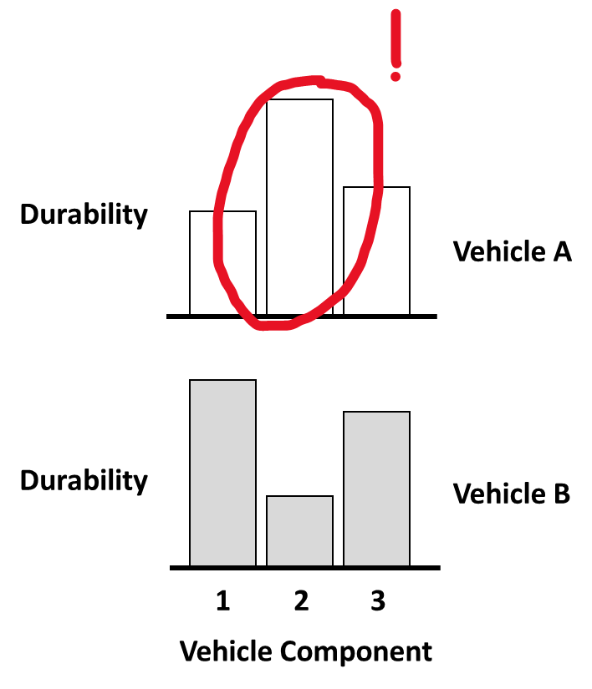

MAX: Component 2 is the most durable component in vehicle A.
Out of all the comparisons participants did in when viewing the adjacent visualization, 22% of them are superlatives that identified the maximum.
30%
20%
comparisons
10%
0%
Adjacent
Overlaid
Stacked
Vertical
Notes:
Superlatives include both comparisons of maximum and minimums.
Let’s look at maximum first.
On the y-axis, I’m going to show the percentage of comparisons that fits in this category, and on the x-axis I have the four visual arrangements we tested.
So this 22% here means that Out of all the comparisons participants did in when viewing the adjacent visualization, 22% of them are superlatives that identified the maximum.
273/1120 (total) = superlative
60 = adjacent superlative.

Slide 55
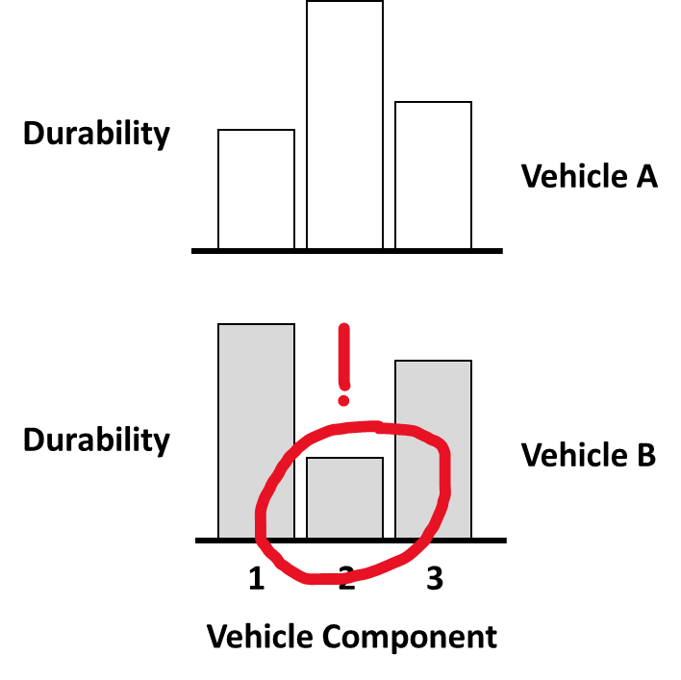
MAX: Component 2 is the most durable component in vehicle A.
MIN: Component 2 is the least durable component in vehicle B.
30%
30%
11% of the comparisons made when viewing the adjacent visualization are about minimums.
20%
20%
comparisons
10%
10%
0%
0%
Adjacent
Overlaid
Stacked
Vertical
Adjacent
Overlaid
Stacked
Vertical
Notes:
We can do the same with the people who looked at minimums.
This 11% here means that…11% of the comparisons made when viewing the adjacent visualization are about minimums.

Slide 56
MAX: Component 2 is the most durable component in vehicle A.
MIN: Component 2 is the least durable component in vehicle B.
30%
30%
20%
20%
comparisons
10%
10%
0%
0%
Adjacent
Overlaid
Stacked
Vertical
Adjacent
Overlaid
Stacked
Vertical
I like to notice big things :D
Notes:
So it looks like the adjacent arrangement most likely triggers a superlative comparison of maximum and minimum.
And that people are more likely to identify the biggest bar, than the smallest bar.

Slide 57
Winner | Verbal Description | Type
 | Component 2 is the most durable component in vehicle A. | Superlatives e.g. max = A
 | The total durability of components in vehicle A is higher than that in vehicle B | A-B comparison e.g., A > B
 | Overall component 2s are more durable than components 3s. | 1-2-3 comparison e.g., 1 > 2
 | In vehicle B, component 1 is more durable than component 2. | Pair-comparison (AB) e.g., B1 > B2
 | Vehicle A’s component 3 is less durable than vehicle B’s component 3 | Pair-comparison (1-2-3) e.g., A3 < B3
Vertical
Overlaid
Adjacent
Stacked
Notes:
Let’s go to our table here, and it looks like we found a winner for the superlative comparison type.

Slide 58

Winner | Verbal Description | Type
adjacent | Component 2 is the most durable component in vehicle A. | Superlatives e.g. max = A
adjacent | The total durability of components in vehicle A is higher than that in vehicle B | A-B comparison e.g., A > B
overlaid stacked | Overall component 2s are more durable than components 3s. | 1-2-3 comparison e.g., 1 < 3
vertical | In vehicle B, component 1 is more durable than component 2. | Pair-comparison (AB) e.g., B1 > B2
overlaid | Vehicle A’s component 3 is less durable than vehicle B’s component 3 | Pair-comparison (1-2-3) e.g., A3 < B3
Adjacent
Notes:
Which is the adjacent type.
People most likely make superlative comparisons when viewing the data in an adjacent visual arrangement.

Slide 59
Winner | Verbal Description | Type
adjacent | Component 2 is the most durable component in vehicle A. | Superlatives e.g. max = A
adjacent | The total durability of components in vehicle A is higher than that in vehicle B | A-B comparison e.g., A > B
overlaid stacked | Overall component 2s are more durable than components 3s. | 1-2-3 comparison e.g., 1 < 3
vertical | In vehicle B, component 1 is more durable than component 2. | Pair-comparison (AB) e.g., B1 > B2
overlaid | Vehicle A’s component 3 is less durable than vehicle B’s component 3 | Pair-comparison (1-2-3) e.g., A3 < B3
20%
10%
0%
Adjacent
Overlaid
Stacked
Vertical
Notes:
For AB comparisons,
People are the most likely to make AB comparisons when viewing adjacent bar charts also.

Slide 60


Winner | Verbal Description | Type
adjacent | Component 2 is the most durable component in vehicle A. | Superlatives e.g. max = A
adjacent | The total durability of components in vehicle A is higher than that in vehicle B | A-B comparison e.g., A > B
overlaid stacked | Overall component 2s are more durable than components 3s. | 1-2-3 comparison e.g., 1 < 3
vertical | In vehicle B, component 1 is more durable than component 2. | Pair-comparison (AB) e.g., B1 > B2
overlaid | Vehicle A’s component 3 is less durable than vehicle B’s component 3 | Pair-comparison (1-2-3) e.g., A3 < B3
Notes:
People are the most likely to make AB comparisons when viewing adjacent bar charts also.

Slide 61
Winner | Verbal Description | Type
adjacent | Component 2 is the most durable component in vehicle A. | Superlatives e.g. max = A
adjacent | The total durability of components in vehicle A is higher than that in vehicle B | A-B comparison e.g., A > B
 | Overall component 2s are more durable than components 3s. | 1-2-3 comparison e.g., 1 < 3
vertical | In vehicle B, component 1 is more durable than component 2. | Pair-comparison (AB) e.g., B1 > B2
overlaid | Vehicle A’s component 3 is less durable than vehicle B’s component 3 | Pair-comparison (1-2-3) e.g., A3 < B3
20%
10%
0%
Adjacent
Overlaid
Stacked
Vertical
Notes:
Here is what the data looks like for 123 comparisons

Slide 62


Winner | Verbal Description | Type
adjacent | Component 2 is the most durable component in vehicle A. | Superlatives e.g. max = A
adjacent | The total durability of components in vehicle A is higher than that in vehicle B | A-B comparison e.g., A > B
overlaid stacked | Overall component 2s are more durable than components 3s. | 1-2-3 comparison e.g., 1 < 3
vertical | In vehicle B, component 1 is more durable than component 2. | Pair-comparison (AB) e.g., B1 > B2
overlaid | Vehicle A’s component 3 is less durable than vehicle B’s component 3 | Pair-comparison (1-2-3) e.g., A3 < B3
Notes:
They are more likely to make 1-2-3 comparisons when viewing the bars overlaid or stacked.

Slide 63
Winner | Verbal Description | Type
adjacent | Component 2 is the most durable component in vehicle A. | Superlatives e.g. max = A
adjacent | The total durability of components in vehicle A is higher than that in vehicle B | A-B comparison e.g., A > B
overlaid stacked | Overall component 2s are more durable than components 3s. | 1-2-3 comparison e.g., 1 < 3
 | In vehicle B, component 1 is more durable than component 2. | Pair-comparison (AB) e.g., B1 > B2
overlaid | Vehicle A’s component 3 is less durable than vehicle B’s component 3 | Pair-comparison (1-2-3) e.g., A3 < B3
40%
30%
20%
10%
0%
Adjacent
Overlaid
Stacked
Vertical
Notes:
Here is what the data looks like for pair-comparisons of AB

Slide 64
Winner | Verbal Description | Type
adjacent | Component 2 is the most durable component in vehicle A. | Superlatives e.g. max = A
adjacent | The total durability of components in vehicle A is higher than that in vehicle B | A-B comparison e.g., A > B
overlaid stacked | Overall component 2s are more durable than components 3s. | 1-2-3 comparison e.g., 1 < 3
vertical | In vehicle B, component 1 is more durable than component 2. | Pair-comparison (AB) e.g., B1 > B2
overlaid | Vehicle A’s component 3 is less durable than vehicle B’s component 3 | Pair-comparison (1-2-3) e.g., A3 < B3
Notes:
They are most likely to make pair-wise AB comparisons, such as B1 is greater than B2, when viewing vertically aligned bars

Slide 65
50%
Winner | Verbal Description | Type
adjacent | Component 2 is the most durable component in vehicle A. | Superlatives e.g. max = A
adjacent | The total durability of components in vehicle A is higher than that in vehicle B | A-B comparison e.g., A > B
overlaid stacked | Overall component 2s are more durable than components 3s. | 1-2-3 comparison e.g., 1 < 3
vertical | In vehicle B, component 1 is more durable than component 2. | Pair-comparison (AB) e.g., B1 > B2
 | Vehicle A’s component 3 is less durable than vehicle B’s component 3 | Pair-comparison (1-2-3) e.g., A3 < B3
40%
30%
20%
10%
0%
Adjacent
Overlaid
Stacked
Vertical
Notes:
Here is what the data looks like for pair-comparisons that keeps the 123 component constant

Slide 66

Winner | Verbal Description | Type
adjacent | Component 2 is the most durable component in vehicle A. | Superlatives e.g. max = A
adjacent | The total durability of components in vehicle A is higher than that in vehicle B | A-B comparison e.g., A > B
overlaid stacked | Overall component 2s are more durable than components 3s. | 1-2-3 comparison e.g., 1 < 3
vertical | In vehicle B, component 1 is more durable than component 2. | Pair-comparison (AB) e.g., B1 > B2
overlaid | Vehicle A’s component 3 is less durable than vehicle B’s component 3 | Pair-comparison (1-2-3) e.g., A3 < B3
Notes:
They are the most likely to make pair-wise 123 comparisons, such as A3 < B3, when vieweing Overlaid bars.

Slide 67
Winner | Verbal Description | Type
adjacent | Component 2 is the most durable component in vehicle A. | Superlatives e.g. max = A
adjacent | The total durability of components in vehicle A is higher than that in vehicle B | A-B comparison e.g., A > B
overlaid stacked | Overall component 2s are more durable than components 3s. | 1-2-3 comparison e.g., 1 < 3
vertical | In vehicle B, component 1 is more durable than component 2. | Pair-comparison (AB) e.g., B1 > B2
overlaid | Vehicle A’s component 3 is less durable than vehicle B’s component 3 | Pair-comparison (1-2-3) e.g., A3 < B3
Adjacent
Notes:
Here is a table summarizing our results.
We can take a couple seconds to digest this.
So What does this mean for visualization recommendation system?

Slide 68
Show me how A compares to B
Recommend this:
Not this:
Durability
Vehicle A
Durability
Vehicle B
1
2
3
1
2
3
1
2
3
Vehicle A
Vehicle B
Vehicle Component
Notes:
So imagine a user wants to know how A compares to B, *click
You would want your recommendation system to show this, rather than this.
In other words, it’s important to choose the visual arrangement that affords the comparison the user intends to do with their search queries, rather than picking a random bar chart.

Slide 69
Effect of Spatial Arrangement on Comparison Affordances
Vertical
Overlaid
Adjacent
Stacked
Visual comparison is a tough topic.
Notes:
This is one first step we took at creating a data-driven taxonomy for visual comparisons.
Given what we know about comparisons in psychology and linguistics, we realize that *click
Visual comparison is a tough topic.

Slide 70







With one simple dataset, there are multiple things to compare, and multiple ways to visualize the data.
Visual comparison is a tough topic.
Notes:
So far we demonstrated that with one simple dataset, there are multiple patterns you could compare, *click * click * click
and there are multiple ways you can choose to visualize that dataset to best support those visual comparisons. *click
But this is just one reason that makes visual comparison a tough topic to study.

Slide 71

With one simple dataset, there are multiple things to compare, and multiple ways to visualize the data.
It’s complicated to make sense comparison sentences, for both humans and machines.
1. Language can be vague
How well did A do compared to B?
What do you mean by “well”?
Visual comparison is a tough topic.
Notes:
Another reason I could think of is that it’s complicated to make sense of comparison sentences, for both humans and machines.
More specifically, because verbal language can be vague, and the meaning of words could change depending on the context or the user goals.
For example, when the user asks, How well did A do compared to B? It’s unclear what the user mean by “well.”

Slide 72
Cindy, you are such a smart person.
Sarcasm?
No, of course not.
Notes:
In human-human interactions, we often resolve ambiguity by asking follow-up questions when we hear ambiguous things.
We can do the same when we design our visualization tools.

Slide 73
Did Student A do well this quarter?
What do you mean by “well”?
Did Student A do score higher than Cindy? Better than Cindy would be well.
Notes:
A user might ask an ambiguous question, and instead of assuming a default, the system could ask the user to clarify certain aspects of their queries.
Say the user asks whether Student A did well this quarter. The word “okay” here is ambiguous. The user might meant it as “okay – they did good enough” or “okay – bad”.
So the system provides some human-machine interactions to clarify what the user means.

Slide 74
Did Student A do well this quarter?
Here are two measures you could use to decide if A did well this quarter.
Notes:
Alternatively, allowing for some sense of ambiguity might not be all bad when recommending visualizations.
It might be productive to reflect that ambiguity back to them, and an example I have here is to provide the user with the two alternative interpretations of ‘okay’ in their sentences.

Slide 75
Did Student A do well this quarter?
Here are two measures you could use to decide if A did well this quarter.
Student A
This quarter
One shows that Student A did as well as other in the class.
One shows that Student A did not do as well as they did last quarter.
Notes:
One example shows that Student A did just as well as others, the other example shows that they didn’t do as well as they did last quarter.
This could encourage the user to think more deeply and critically about their goals and their data, as they gain more perspectives.
I imagine this interaction component can open even more opportunities for future research at the intersection of natural language processing and visualization research, in not just comparison tasks, but other data analytic and data story telling tasks as well,

Slide 76
With one simple dataset, there are multiple things to compare, and multiple ways to visualize the data.
It’s complicated to make sense comparison sentences, for both humans and machines.
1. Language can be vague
How well did A do compared to B?
What do you mean by “well”?
2. Translating natural language sentence to machine-interpretable queries is underexplored.
Visual comparison is a tough topic.
Notes:
Another component that makes it difficult to make sense of comparison sentences, is that methods for Translating natural language sentence to machine-interpretable queries is underexplored.
This is a problem for both research and practice. Let me show you what I mean.

Slide 77
Winner | Verbal Description | Type
adjacent | Component 2 is the most durable component in vehicle A. | Superlatives e.g. max = A
adjacent | The total durability of components in vehicle A is higher than that in vehicle B | A-B comparison e.g., A > B
overlaid stacked | Overall component 2s are more durable than components 3s. | 1-2-3 comparison e.g., 1 < 3
vertical | In vehicle B, component 1 is more durable than component 2. | Pair-comparison (AB) e.g., B1 > B2
overlaid | Vehicle A’s component 3 is less durable than vehicle B’s component 3 | Pair-comparison (1-2-3) e.g., A3 < B3
Notes:
When I went over the results, you may have noticed that we used some mathematical expressions to represent the comparisons people did.
Segmenting and tokenizing key words from the natural language, and transforming them into something a machine would understand, would be very critical for implementing recommendation systems like this.
But no one has figured out how to do this well, that’s why we had to spend hours and hours manually code these, cross comparing drawings and verbal sentences. Even with the drawings, some times it is still difficult for us to figure out exactly what they mean and what comparison they were doing.
Also, sometimes especially concise sentences can mean a great deal of things.

Slide 78
Durability
Vehicle A
Durability
Vehicle B
1
2
3
Vehicle Component
16 words
Part 3 of Vehicle A is less durable than Part 2, but more than Part 1.
A3 < A2
A3 > A1
Notes:
Let’s look at this visualization on car durability that we are familiar with as an example.
Let’s look at one sentence, comparing A1, A2, and A3.
Part 1 of Vehicle A is less durable than part 2 of Vehicle A.
This is easily translated into these mathematical expresses ions. No problem.

Slide 79




Durability
Vehicle A
Durability
Vehicle B
1
2
3
Vehicle Component
16 words
12 words
Part 3 of Vehicle A is less durable than Part 2, but more than Part 1.
The durabilities are the same for both vehicles, but for different parts.
A3 < A2
A3 > A1
(A1 + A2 + A3) = (B1 + B2 + B3)
A1 = B2 & A1 != B1
A2 = B1 & A2 != B2
A3 = B3
Notes:
But let’s look at this other one.
The durability's are the same for both vehicles, but for different parts.
Now this person noticed that A2 is similar to B1, A1 is similar to B2, and A3 is similar to B3. So the total durability for the two vehicles are similar.
But we have to write many more expressions to translate this sentence.

Slide 80
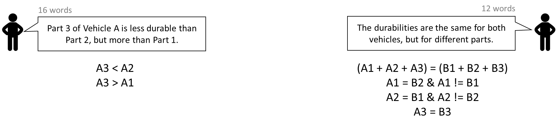


Durability
Vehicle A
Durability
Vehicle B
1
2
3
Vehicle Component
Visual comparison is a tough topic.
Notes:
We see that the number of words in natural language is not proportional to the number of mathematical expressions you can generate from them.
And this relates back to my previous point, Comparison is a tough topic,

Slide 81
With one simple dataset, there are multiple things to compare, and multiple ways to visualize the data.
It’s complicated to make sense comparison sentences, for both humans and machines.
1. Language can be vague
How well did A do compared to B?
What do you mean by “well”?
2. Translating natural language sentence to machine-interpretable queries is underexplored.
Visual comparison is a tough topic.
Notes:
and Translating natural language sentence to machine-interpretable queries is underexplored.
So in summary, visual comparison is a tough topic that is ripe for future interdisciplinary investigation, I imagine it requires teams with multiple forms of expertise to figure this out. I’m currently working with folks with backgrounds in computational linguistics, computer networks, and cognitive psychology to tackle this problem, there is a lot to learn, but it’s all very exciting.

Slide 82






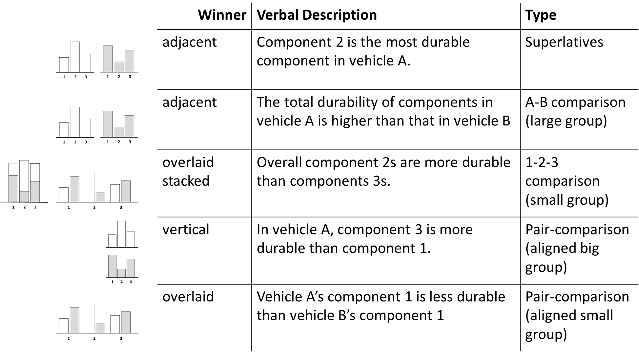









cxiong@u.northwestern.edu
@theCindyXiong
Notes:
I think that’s all I have. And I realized that this is my last brownbag talk here at Northwester, I want to especially thank everyone for all your support in the past five years!
Thank you all for listening to me. Happy to answer questions.

